Slide 1
Games Bootcamp
Assets & Unity Asset Store

Slide 2
Recap
Scripting. Conditions, Containers, Functions & Loops

Slide 3
Table of contents
01
What are assets
04
Asset Resources
02
Software & Tools
05
Integrating Assets
03
Self-Made vs Sourced
Where to find assets
What is used to make what?
How to add assets to your project
Things to consider

Slide 4
01
What is an Asset?

Slide 5
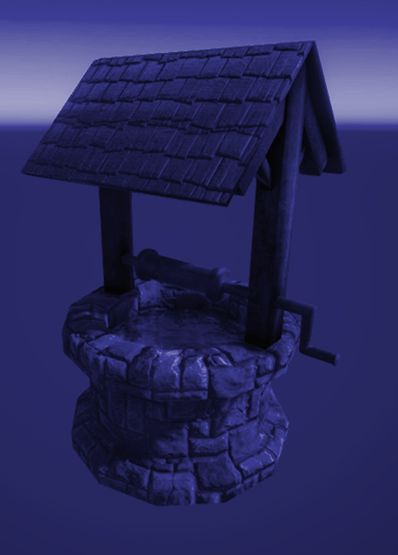
Assets
Any resource or file used in the game.
2D Art: Sprites, Textures, UI Elements
3D Art: Models Character Rigs, Textures
Animations
SFX & VFX

Slide 6
02
Software & Tools
What is used to make what?

Slide 7
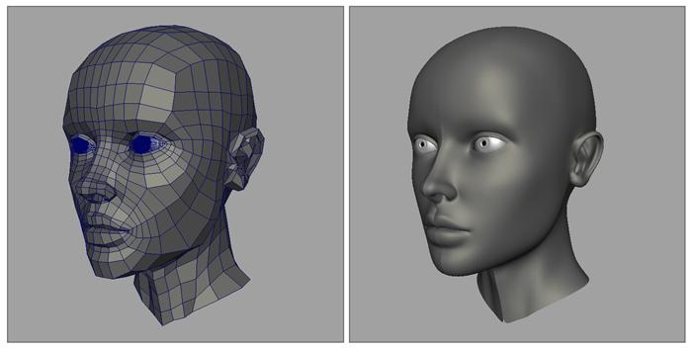
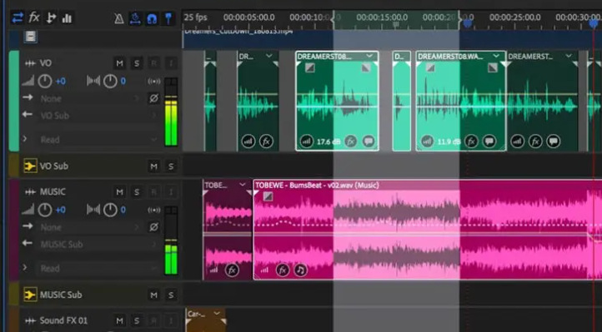
Asset Creation Software
3D Modeling & Animation
2D Graphics
Sound
Blender, AutoDesk Maya, 3DSMax, ZBrush
Adobe Photoshop, Illustrator, GIMP
Audacity, Adobe Audition

Slide 8
03
Self-Made vs Sourced
Things to consider

Slide 9
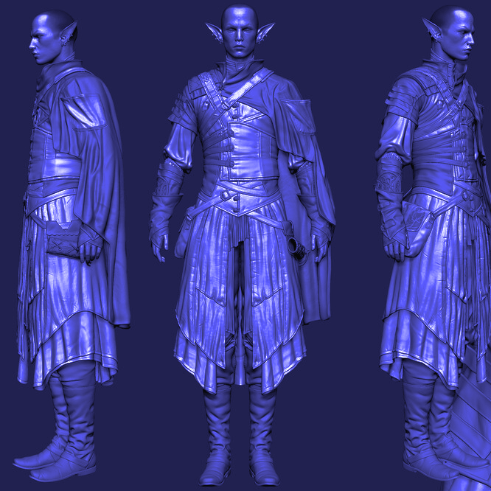
Self-Made Assets
Unique assets are a major factor in making your game stand out
Time vs Cost
It takes a very long time (months) to develop art assets
Licenses are expensive
Maya is £256 a month

Slide 10
Sourced Assets
Sourced assets need to be properly licensed. They can be a cheaper alternative
Public Domain (CC0) | free to use for any purpose
CC Attribution | similar to CC0 but attribution (credits) are required
Royalty Free | Paid for once. Often used for sounds and stock images.
Proprietary | All Rights Reserved. Need explicit permission from CH
Open Source | MIT, GNU, Apache etc. Common in software development.

Slide 11
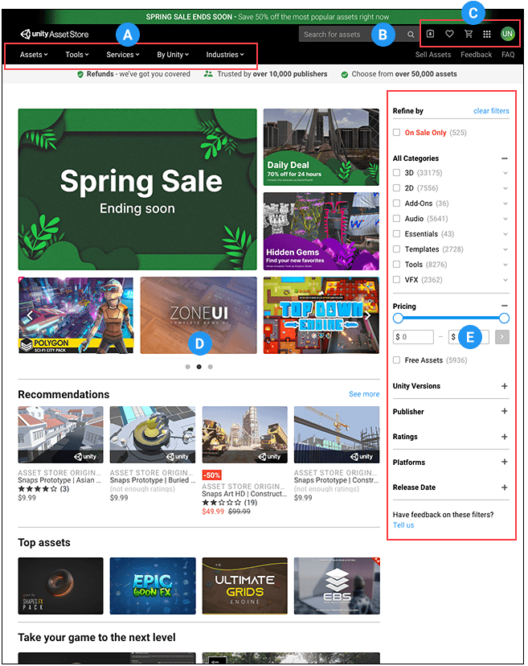
Unity Asset Store
EULA Agreement
You can use the assets in any of your unity projects
You cannot distribute it separately
https://assetstore.unity.com/

Slide 12
04 Asset Resources
Remember to check the license!
Sound
SoundBible - https://soundbible.com/
Freesound - https://freesound.org/
Zapsplat - https://www.zapsplat.com/
Epidemic Sound - https://www.epidemicsound.com/
2D Sprites
Kenney.nl - https://kenney.nl/assets
OpenGameArt - https://opengameart.org/
GameDev Market - https://www.gamedevmarket.net/
CraftPix - https://craftpix.net/
3D Models
Sketchfab - https://sketchfab.com/
TurboSquid - https://www.turbosquid.com/
Free3D - https://free3d.com/
Fonts
Google Fonts - https://fonts.google.com/
DaFont - https://www.dafont.com/
Font Squirrel - https://www.fontsquirrel.com/
1001 Fonts - https://www.1001fonts.com/
Notes:
Sound:
SoundBible - https://soundbible.com/
Freesound - https://freesound.org/
Zapsplat - https://www.zapsplat.com/
Epidemic Sound - https://www.epidemicsound.com/
2D Art and Sprites:
5. Kenney.nl - https://kenney.nl/assets
OpenGameArt - https://opengameart.org/
GameDev Market - https://www.gamedevmarket.net/
CraftPix - https://craftpix.net/
3D Models:
9. Sketchfab - https://sketchfab.com/
TurboSquid - https://www.turbosquid.com/
Unity Asset Store - https://assetstore.unity.com/
Free3D - https://free3d.com/
Fonts:
13. Google Fonts - https://fonts.google.com/
DaFont - https://www.dafont.com/
Font Squirrel - https://www.fontsquirrel.com/
1001 Fonts - https://www.1001fonts.com/
Music and Background Tracks:
17. Incompetech - https://incompetech.com/music/
Bensound - https://www.bensound.com/
Free Music Archive - https://freemusicarchive.org/
Purple Planet Music - https://www.purple-planet.com/

Slide 13
Thanks!

